Slide 1

Credit Card Fraud Detection
A machine learning project focused on detecting fraudulent credit card transactions. This is critical for financial security. The project utilizes machine learning to minimize financial losses for institutions and customers.

Slide 2

Project Overview & Importance
Machine Learning
Minimize Losses
Using machine learning to identify fraudulent transactions.
Critical for minimizing financial losses for institutions and customers.
Enhance Security
Enhances transaction system security and trust.

Slide 3
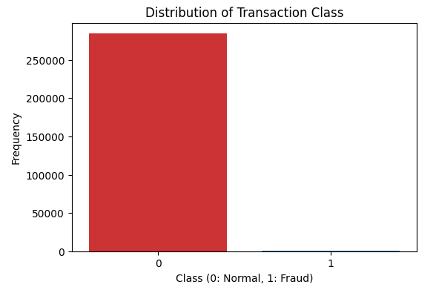
Dataset & Attributes
Dataset
Credit Card Fraud Detection (Kaggle / ULB)
Transactions from September 2013
Attributes
284,807 Transactions
Independent Variables: V1-V28 (PCA), Amount
Imbalanced: 0.17% Fraudulent
Dependent Variable: Class (0:Normal, 1:Fraud)

Slide 4





Methodology & Approach
Exploratory Data Analysis
Examined data structure and visualized class imbalance.
Data Preprocessing
Split data (70/30) and applied feature scaling.
Model Exploration
Considered several algorithms, KNN selected for detailed analysis.
Evaluation
Used precision, recall, F1-score, and confusion matrix.

Slide 5



KNN Model - Optimization
Preprocessing
2
Features scaled using StandardScaler.
Why KNN?
1
Selected for its effectiveness.
Optimal K
3
Elbow Method to identify optimal K.

Slide 6
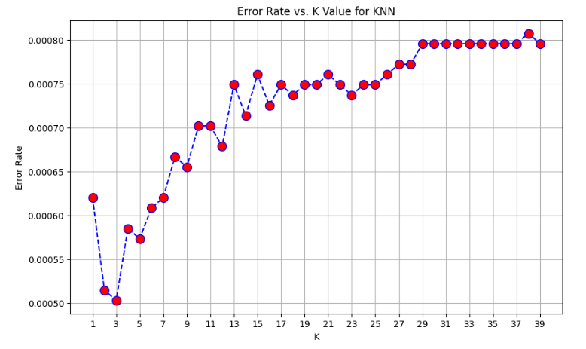
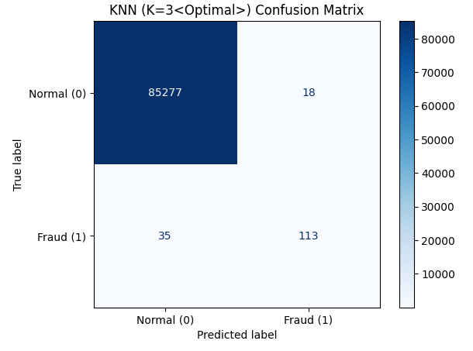
KNN Model – Metrics

Slide 7
KNN (K=3) Results Rationale
Optimal K
1
K=3 was chosen for balance.
Good Recall
2
Classify fraud cases correctly.
Good Precision
3
Minimize false positives.

Slide 8
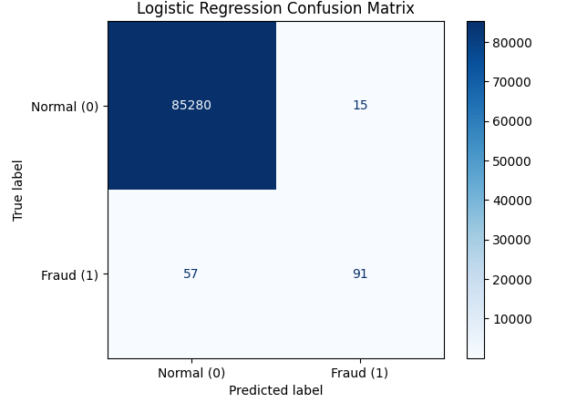
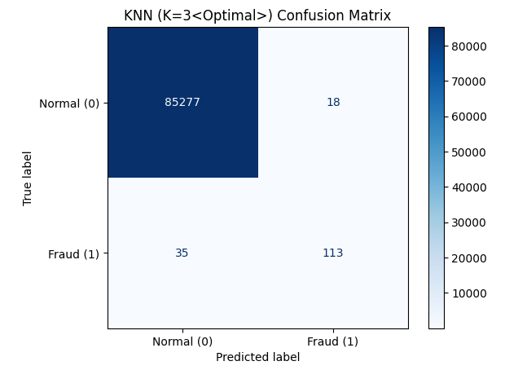
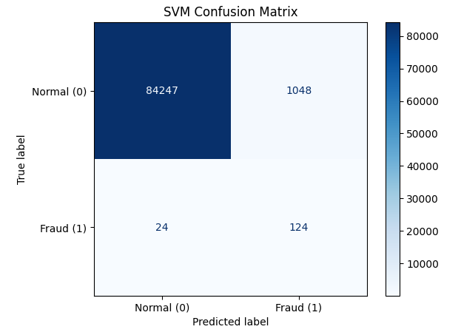
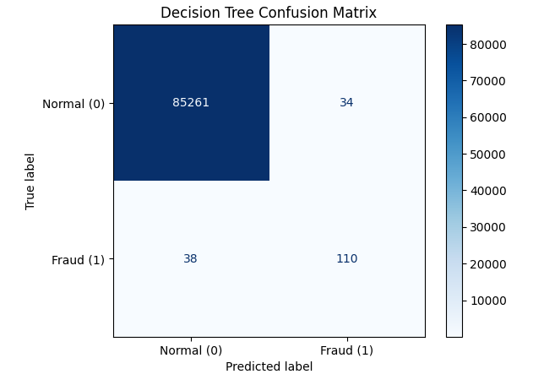

Slide 9

Conclusion
Successful Application
Key Steps
Data preprocessing
Applied ML to fraud detection.
Model selection
Evaluation Metrics
Essential due to class imbalance.

Slide 10
Thank You
Questions?

